Slide 1



Explanation
This presentation contains basic information on BoekStart for babies and BoekStart at daycare. You can use this presentation flexibly and adapt it to the target group and local situation. Possible target groups are for example: the municipality, pedagogical workers or the management of the daycare.
Dependent on the target group, additional information can be added on for example:
BoekStart-BoekenPret
The calculation model of BoekStart at daycare
BoekStartcoach
VoorleesExpress
de Bibliotheek op school (The Library at school)
Local facts and figures

Slide 2


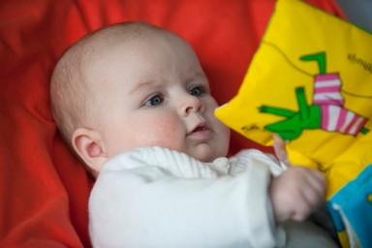

Slide 3


BoekStart for babies
> Reading enhancement programme for young children (0-2)
> Goal: connecting parents with babies to the library by means of books and reading
> BoekStart is the start of a ongoing reading line
> Important for the prevention of illiteracy

Slide 4



BoekStart for babies
> BoekStart for babies started in 2008
> Initiative by the Ministry of OCW, national organisation by Stichting Lezen and the Koninklijke Bibliotheek
> Emphasis on the active role of the Library
> Cooperation of the municipality consultation office, daycare, maternity care and bookstore
> Part of the action programme Tel mee met Taal (2016-2018)

Slide 5
Argumentation
> Children that read perform better in society
To read or not to read: Scientific research of Suzanne Mol (dec 2010)
> Every dollar invested in VVE converts into 9 dollars
Nobel laureate James Heckman
> BoekStart makes babies brighter
Heleen van den Berg (Feb 2015)
> More reading aloud, better in language
Kunst van Lezen, Kees Broekhof & Maryse Nijhof-Broek (Sep 2017)

Slide 6
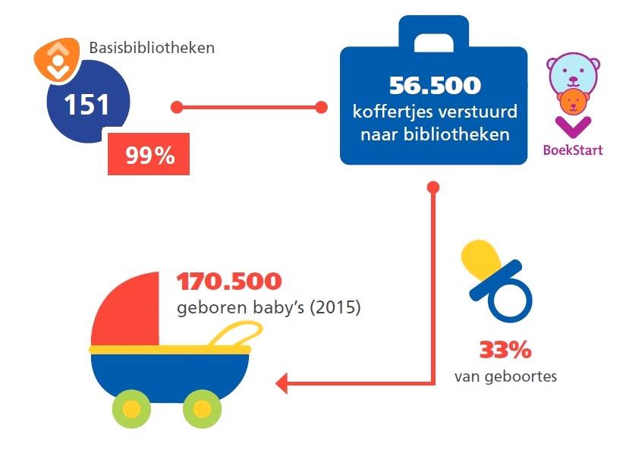
Status
> Baby of ca. 3 months old: parents receive a voucher of the municipality to have their baby join the library for free
> Free BoekStartsuitcase with 2 books
> Almost all libraries in the Netherlands joined BoekStart
Notes:
Infographic from Feitenrelaas Kunst van Lezen (Sep. 2017)

Slide 7
Research
Research to the effects of BoekStart by the University of Leiden:
BoekStart makes babies brighter (2015)
Heleen van den Berg, Adriana G. Bus
The research found that parents who participate in Boekstart and read aloud to their babies before the age of 8 months old, score higher on language. After 15 months positive effects are noticeable in the vocabulary. ‘BoekStart makes babies brighter’ shows not only that reading aloud in an early stage is effective, however also shows which children benefit most by this.

Slide 8
Results parents
BoekStart parents:
> read aloud to their children in an early stage
> visit the library more frequently
> talk more to their child and use an increased variety of words
> are more up to date with the book offers
> continue to read aloud to children with ‘difficult’ behaviour
Notes:
Source: Research University of Leiden BoekStart maakt baby’s slimmer (2015) Heleen van den Berg, Adriana G. Bus

Slide 9
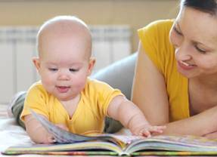
Results children
BoekStart children:
> watch less television
> want to be read aloud more often
> those with ‘difficult’ behaviour will benefit more of BoekStart
> score higher levels on language
The effects are stronger on a long-term basis (snowball effect)
Notes:
Source: Research University of Leiden BoekStart maakt baby’s slimmer (2015) Heleen van den Berg, Adriana G. Bus

Slide 10
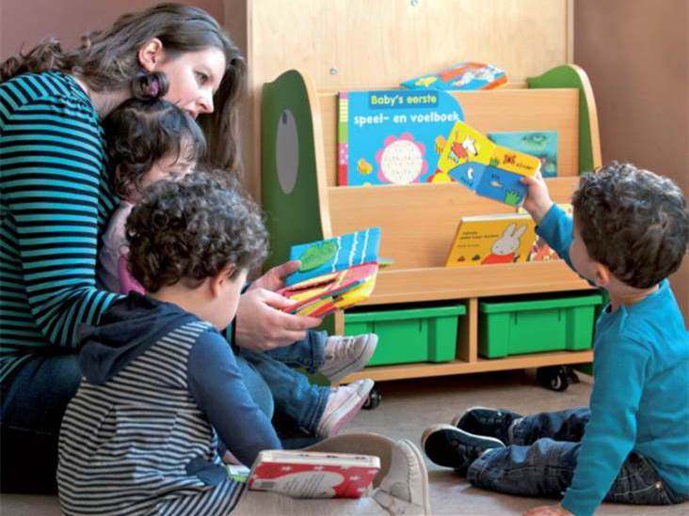
BoekStart at daycare

Slide 11
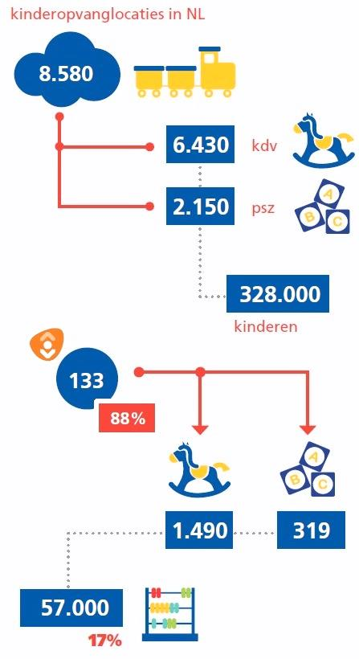
BoekStart at daycare
> Expansion of BoekStart for babies since 2011
> Focused on children aged 0-4 in daycare > Goal: connecting children, parents and pedagogical workers to the library by means of books and reading
> Important for the prevention of illiteracy
Notes:
Infographic from Feitenrelaas Kunst van Lezen (Sep 2017)

Slide 12
Benefits daycare
> More expertise at hand
> Good reading aloud climate according to the pedagogical requirements of the daycare
> Profiling
> Tapping into new means

Slide 13
Benefits Library
> More Library members
> More expertise at hand
> Increased purchase of services
> Visibility
> Tapping into new means

Slide 14
Central elements
> Attractive reading spot at the daycare
> Constructing a starting collection with adequate books
> Expertise enhancement of pedagogical workers > Participation of parents
> Reading aloud plan in order to incorporate reading aloud into daily life
> Cooperate with partners in a reading enhancement network

Slide 15
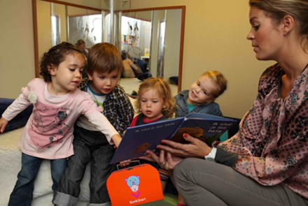
Quotes pedagogical workers
‘I was already reading aloud in the group, however now i learnt to be more critical. Which book will I read to which child? Also I pay more attention now to whether the text matches the illustration and whether the story matches the age of the toddler. My perspective is more from the eyes of the child now.’
‘It is great to put the books at the centre of attention and show this focus to the parents. This way you also inspire the parents to use the books.’
‘Twice a year we participate in an ‘inspiration afternoon’ with the Library and we ask them frequently which books fit within a certain theme. In the past we borrowed a book every now and then, now we are actually collaborating’

Slide 16

More information:
www.boekstart.nl (for parents)
www.boekstartpro.nl (for professionals)
www.leesmonitor.nu (research)

Slide 17

Extension: BoekStart - BoekenPret
> Reaches parents that read aloud too little through daycare: expand the the joy of reading for children and parents, and give professionals the tools to insert reading aloud in the familyroutine and KOV.
> 500 hours of reading aloud to children of a young age (between 0-6 years), results in positive reading motivations and improved language competences.
> Local collaboration: Library, youth healthcare, daycare, toddler groups, welfare work and municipality.

Slide 18

Workable elements BoekStart-BoekenPret
> Continuous readingline: daycare – kindergarten group
> Structured reading aloud sessions: in the home setting and in the child centres
> Rich reading environment: taking home of the books and attractive reading spots in child centres
> Family focussed approach and support
> Step by step guidance of parents without a reading aloud background
> Support for parents for home activities (play and discovery books)
> Strenghtening of the role of parents
> Professionalisation of pedagogical workers in the child centres

Slide 19
Extension: BoekStartcoach
The Library comes to the parents!
> Intensification of the goal of BoekStart: make (low literate) parents conscious of the importance of reading aloud and increase the percentage of (low literate) parents that pick up the suitcase and have their baby become a member.
> Target group: (low literate) parents of young children that visit the consultation office. The pediatrician/nurse refers the low literate families structurally to the BoekStartcoach in the waiting room.
> Cooperation of the Library with the youth healthcare and municipality: extra effort apart from the referral of the consultation office and the letter with a voucher of the municipality.

Slide 20
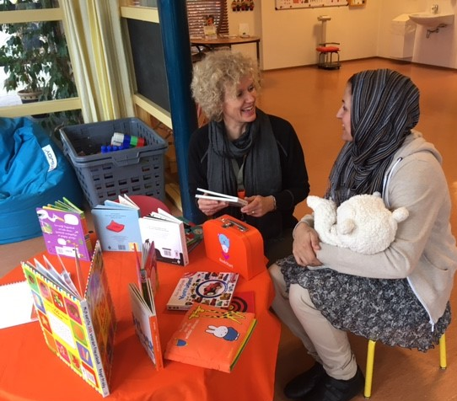
The BoekStartcoach…
> is structurally present at the consultation office
> has its own spot in the waiting room
> is recognizable through the BoekStart materials
> starts conversations with the parents on the importance of reading aloud for the language development
> promotes the joy of reading aloud
> answers questions about reading and media education
> gives advice to polyglot parents on the use of their own language for reading aloud
> Is temporally present in the Library during special BoekStart hours and functions as a point of contact for parents with young children.

Slide 21

VoorleesExpress
Every story starts with language
20 weeks  1 fixed moment in the week  volunteer comes at home reading aloud and language activities  children aged 2 till 8 years (with a chance of language deficiency)  enrich the language environment in the family  helping parents so that they can stimulate their children adequately in the language development
The VoorleesExpress:
> Focus on the prevention of illiteracy
> Strengthen the connection between school and home
> Strenghten the collaboration with parents and parent engagement
> Offers help in the guidance to other programmes (such as: reading, writing, digital skills)
> Creates valuable encounters
> Citizen participation: high attendence of volunteers
www.voorleesexpress.nl

